Slide 1

Technology: Java
Farm Management System

Slide 2
INDEX
Abstract
Introduction
Literature review
Existing Method
Drawbacks
Proposed method
Advantages
Implementation
Architecture
Modules
UML diagrams
Results
Conclusion
References

Slide 3
ABSTRACT
The amazing developments in science and technology have raised the bar for human living standards. Without these improvements, the entire planet will be physically congested. Compared to other projects now in existence, this project is innovative in that it simplifies the process of getting farming. Java has been used to implement this project. The project's goal is to create an application software to lessen the human labour involved in keeping track of the farming of different crops consumed by people and getting farming on different ways based on seasonal wise. The fast changing environment, including difficult market conditions and a high exposure to financial risks are major reasons for changing production policy. Farm Management Systems appear to be a powerful tool to deal with the new conditions. However, farmers still rely more on their intuition than on proper management tools, when it comes to running a farm business. Many farmers do not use Farm management for various reasons, like lack of knowledge and the complexity of many available farm managements. In particular for small to medium-sized farms and for multifunctional farms appropriate farm management hardly exist.
Keywords: Farming, Crops, Products , Admin, Customer, Orders etc.

Slide 4
INTRODUCTION
Nowadays people are putting more and more emphasis on quality of life. The food safety concern and attention are also increasing. The dairy products health security as an important part of food safety, has been on the agenda. Therefore, how can guarantee food safety has become an important research subject. Dairy farming has always been a traditional industry, but the industry development is uneven. Large dairy farms purchase foreign equipment and production experience to manage the zap, but due to limits on various aspects of funds, small or remote areas will not be able to introduce advanced equipment, they still adopt the traditional way to zap daily management. This way influence cow production management and technical support, in this context, we urgently need a reliable and advanced management methods to manage the zap.
This paper is organized as follows. In section 2, the Control Scheme And Design Of The System is presented. In section 3, according to the principle of the system, the Overall Design is given. The Hardware Design Of Actuator System is introduced in section 4. And in section5, Software Programming is completed. Finally, our work of this paper is summarized in the last section.

Slide 5
LITERATURE REVIEW
S. No | Journal Type with year | Authors | Title | Outcomes
1 | 1999 | Bryant, L. | Farmers’ usage patterns and impact on the farm management | we have tried to remove the drawbacks. It was found that the human effort is too much in the traditional electric meter reading and efficiency of traditional process is much less than it could be with this new process
2 | 2010 | Grubb, J | A Low Cost Automated Livestock Tracking System | This research will develop and evaluate a prototype data acquisition system for tracking livestock.
3 | 2004 | Cerosaletti, P.E., Fox, D.G., Chase, L.E | Phosphorus Reduction Through Precision Feeding of Dairy Cattle, Journal of Dairy Science | This would slow the rate of phosphorus accumulation in agricultural soils in the Cannonsville Basin
4 | 2001 | Kuhlmann, F., Brodersen | Information technology and farm management | farmers want to increase the economic efficiency of their production and marketing processes by decreasing waste and friction

Slide 6
EXISTING METHOD
People now a days use a manual process for buying products and required things,due to some reasons. They have got used to the manual process and they can go along with it even though there are concerns associated with it. They are reluctant to change their current process since it will be an extra effort. The farm management for a new solution. However, the customers face immense problems with the current procedure of using this manual process to getting formation items.
Dis advantages:
Required Manual efforts
Requires more time

Slide 7
PROPOSED METHOD
To overcome the problem with an existing system, we are implementing an application called farm management system using java. Using this application customers can get all the products information via through his own accounts. After that customer can able to add products to the cart and buy the required things through online.
Advantages:
Manual process not required
Requires less time

Slide 8
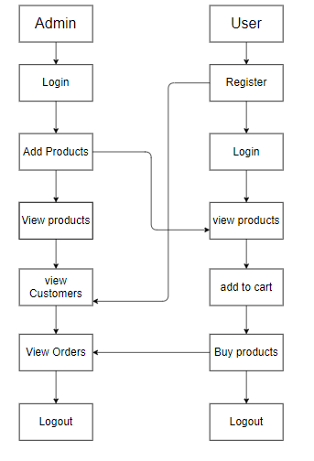
PROPOSED METHOD
Block diagram of proposed method

Slide 9
IMPLEMENTATION
Install the required packages
Defining the problem association.
Runs admin and user modules.

Slide 10
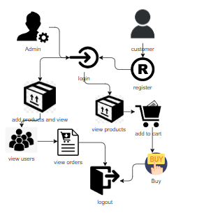
ARCHITECTURE
Architecture diagram of proposed method

Slide 11
SYSTEM REQUIREMENTS
SOFTWARE AND HARDWARE REQUIREMENTS:
Operating system : Windows 7 or 7+
Ram : 8 GB
Hard disc or SSD : More than 500 GB
Processor : Intel 3rd generation or high with 8 GB Ram
Software’s : Java 8 or high version, Eclipse.

Slide 12
MODULES
This project contains four modules as mentioned in below are:
Admin:
Admin must login with valid default credentials, Admin will add the products and he can able to view all added products. He can able to view all the registered customers and admin can maintain the customers , view all the orders ordered by customers
User:
User can register with his required details and must be login with valid credentials. He can able view all the products which are added by admin, add to the cart which are required and buy from cart.

Slide 13
UML DIAGRAMS
Uml stands for unified modeling language. Uml is a standardized general-purpose modeling language in the field of object-oriented software engineering. The standard is managed, and was created by, the object management group.
The goal is for uml to become a common language for creating models of object oriented computer software. In its current form uml is comprised of two major components: a meta-model and a notation. In the future, some form of method or process may also be added to; or associated with, uml.
The unified modeling language is a standard language for specifying, visualization, constructing and documenting the artifacts of software system, as well as for business modeling and other non-software systems.
The uml represents a collection of best engineering practices that have proven successful in the modeling of large and complex systems.

Slide 14
The uml is a very important part of developing objects oriented software and the software development process. The uml uses mostly graphical notations to express the design of software projects.
GOALS:
The Primary goals in the design of the UML are as follows:
Provide users a ready-to-use, expressive visual modeling Language so that they can develop and exchange meaningful models.
Provide extendibility and specialization mechanisms to extend the core concepts.
Be independent of particular programming languages and development process.
Provide a formal basis for understanding the modeling language.
Encourage the growth of OO tools market.
Support higher level development concepts such as collaborations, frameworks, patterns and components.
Integrate best practices.

Slide 15
Use case diagram:
A use case diagram in the unified modeling language (uml) is a type of behavioral diagram defined by and created from a use-case analysis. Its purpose is to present a graphical overview of the functionality provided by a system in terms of actors, their goals (represented as use cases), and any dependencies between those use cases. The main purpose of a use case diagram is to show what system functions are performed for which actor. Roles of the actors in the system can be depicted.

Slide 16
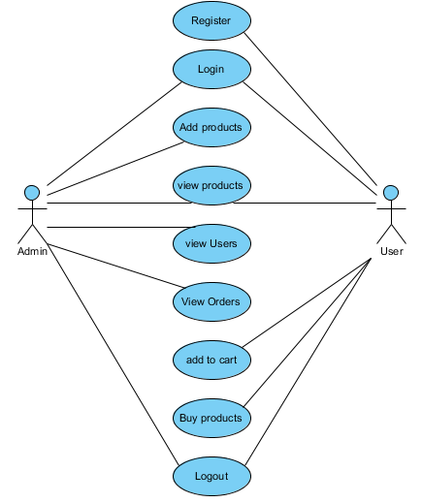

Slide 17
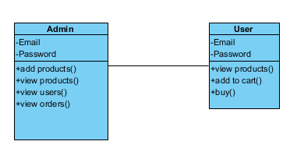
Class diagram:
In software engineering, a class diagram in the unified modeling language (uml) is a type of static structure diagram that describes the structure of a system by showing the system's classes, their attributes, operations (or methods), and the relationships among the classes. It explains which class contains information.

Slide 18
Sequence diagram:
A sequence diagram in unified modeling language (uml) is a kind of interaction diagram that shows how processes operate with one another and in what order. It is a construct of a message sequence chart. Sequence diagrams are sometimes called event diagrams, event scenarios, and timing diagrams.

Slide 19
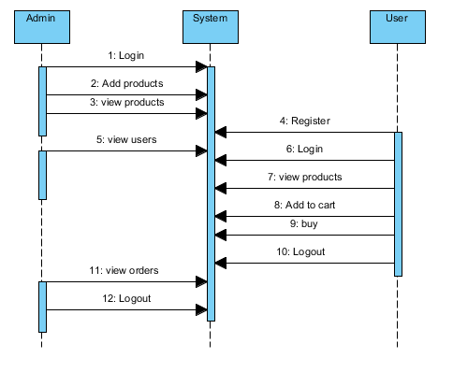

Slide 20
Collaboration diagram:
In collaboration diagram the method call sequence is indicated by some numbering technique as shown below. The number indicates how the methods are called one after another. We have taken the same order management system to describe the collaboration diagram. The method calls are similar to that of a sequence diagram. But the difference is that the sequence diagram does not describe the object organization whereas the collaboration diagram shows the object organization.

Slide 21
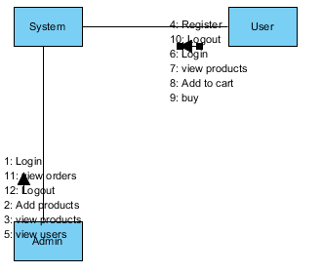

Slide 22
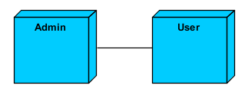
Deployment diagram:
Deployment diagram represents the deployment view of a system. It is related to the component diagram. Because the components are deployed using the deployment diagrams. A deployment diagram consists of nodes. Nodes are nothing but physical hard ware’s used to deploy the application.

Slide 23
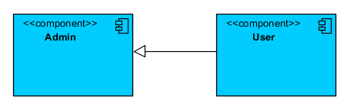
Component diagram:
Component diagrams are used to describe the physical artifacts of a system. This artifact includes files, executable, libraries etc. So the purpose of this diagram is different, component diagrams are used during the implementation phase of an application. But it is prepared well in advance to visualize the implementation details. Initially the system is designed using different uml diagrams and then when the artifacts are ready component diagrams are used to get an idea of the implementation.

Slide 24
Activity diagram:
Activity diagrams are graphical representations of workflows of stepwise activities and actions with support for choice, iteration and concurrency. In the unified modeling language, activity diagrams can be used to describe the business and operational step-by-step workflows of components in a system. An activity diagram shows the overall flow of control.

Slide 25
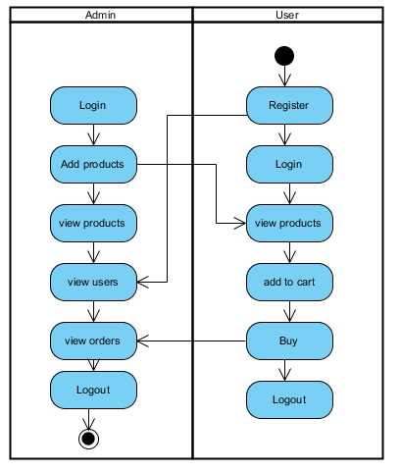

Slide 26
ER Diagram:
An Entity–relationship model (ER model) describes the structure of a database with the help of a diagram, which is known as Entity Relationship Diagram (ER Diagram). An ER model is a design or blueprint of a database that can later be implemented as a database. The main components of E-R model are: entity set and relationship set.
An ER diagram shows the relationship among entity sets. An entity set is a group of similar entities and these entities can have attributes. In terms of DBMS, an entity is a table or attribute of a table in database, so by showing relationship among tables and their attributes, ER diagram shows the complete logical structure of a database. Let’s have a look at a simple ER diagram to understand this concept.

Slide 27
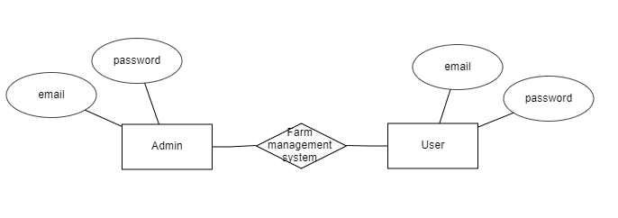

Slide 28
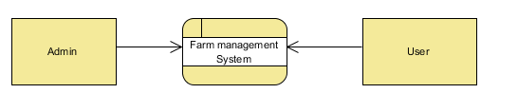
DFD Diagram:
A Data Flow Diagram (DFD) is a traditional way to visualize the information flows within a system. A neat and clear DFD can depict a good amount of the system requirements graphically. It can be manual, automated, or a combination of both. It shows how information enters and leaves the system, what changes the information and where information is stored. The purpose of a DFD is to show the scope and boundaries of a system as a whole. It may be used as a communications tool between a systems analyst and any person who plays a part in the system that acts as the starting point for redesigning a system.

Slide 29
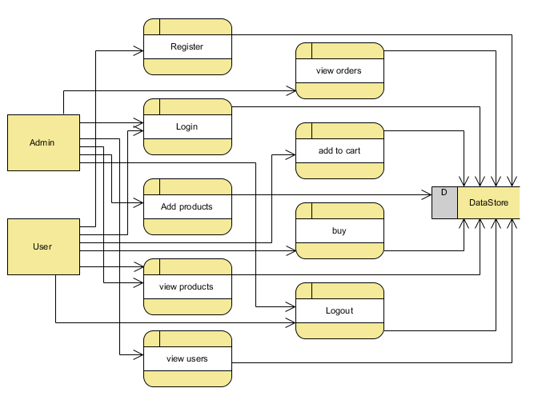

Slide 30
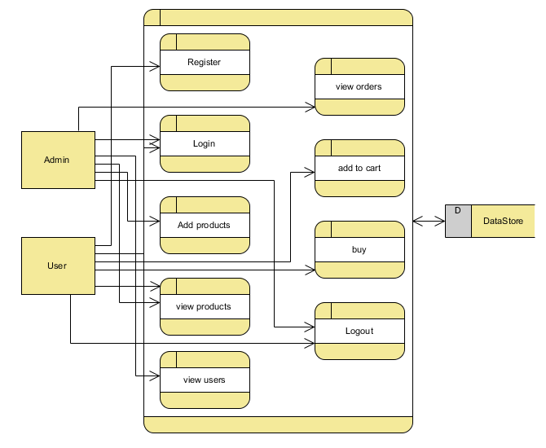

Slide 31
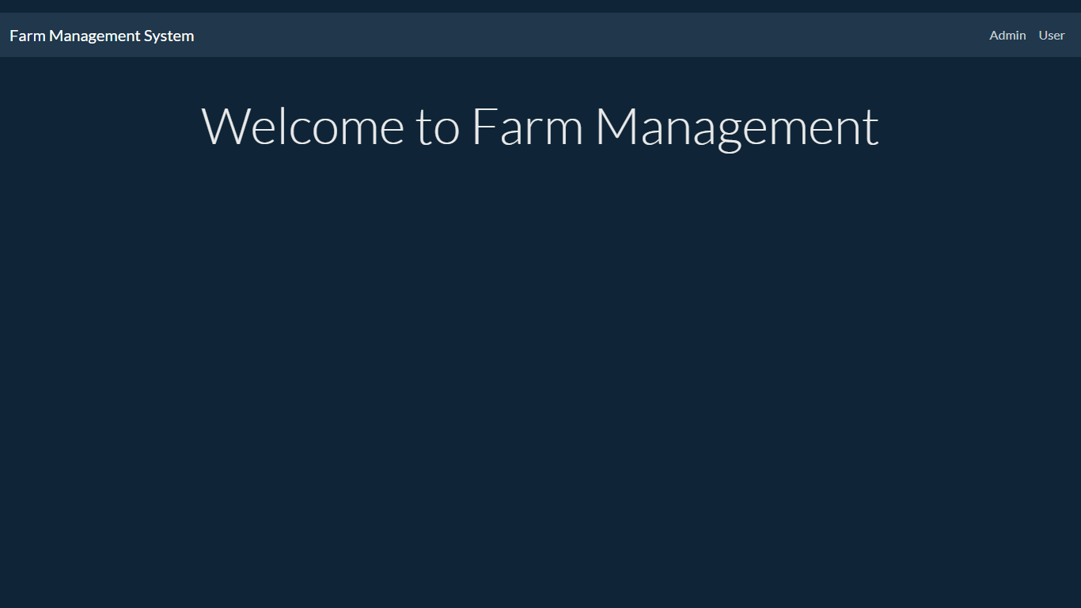
RESULTS
Home page: This is the home page of Farm management System.

Slide 32
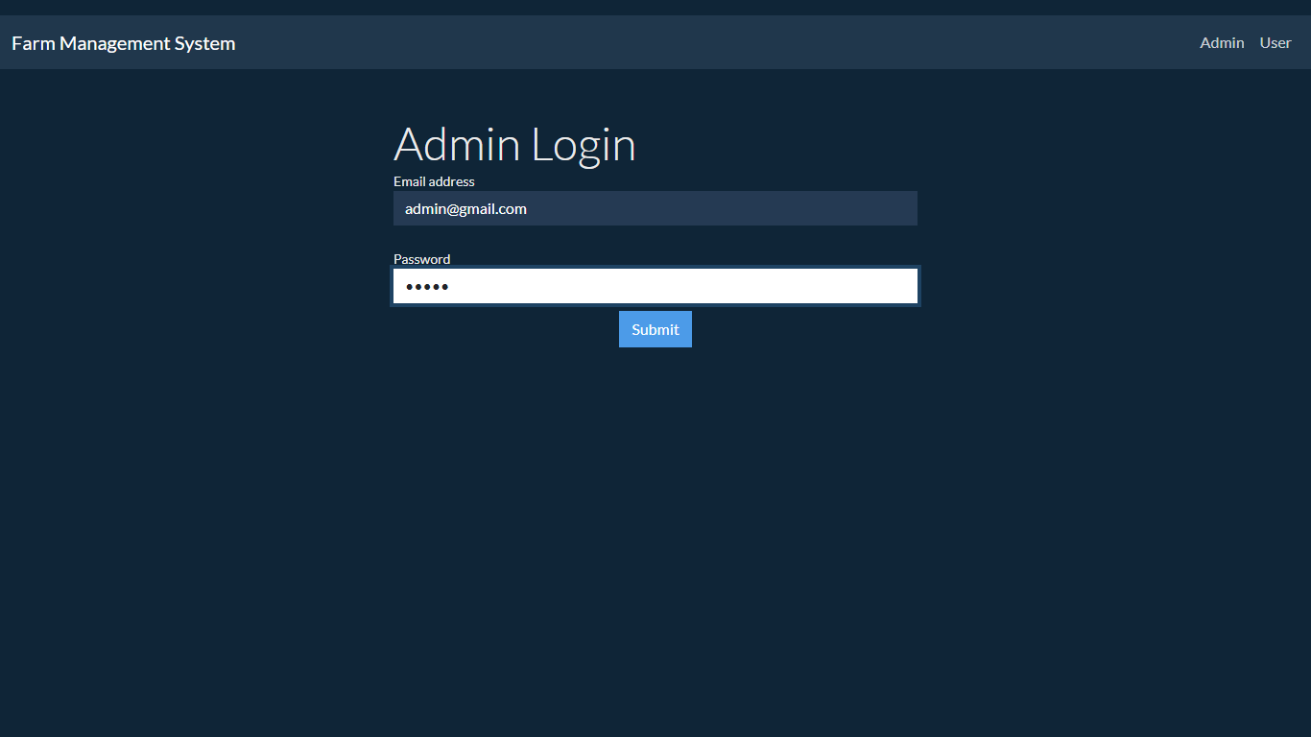
Admin Login page: In this page Admin can login with their required details.

Slide 33
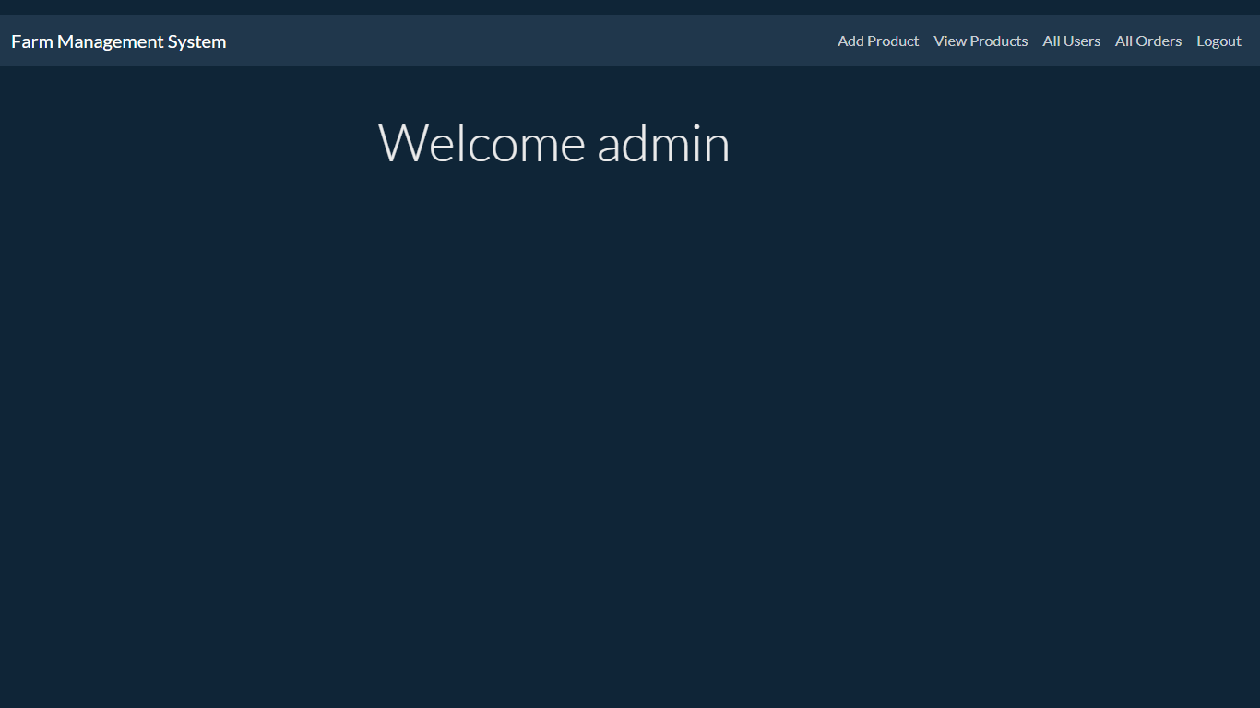
Admin Home: This is the admin Home page.

Slide 34
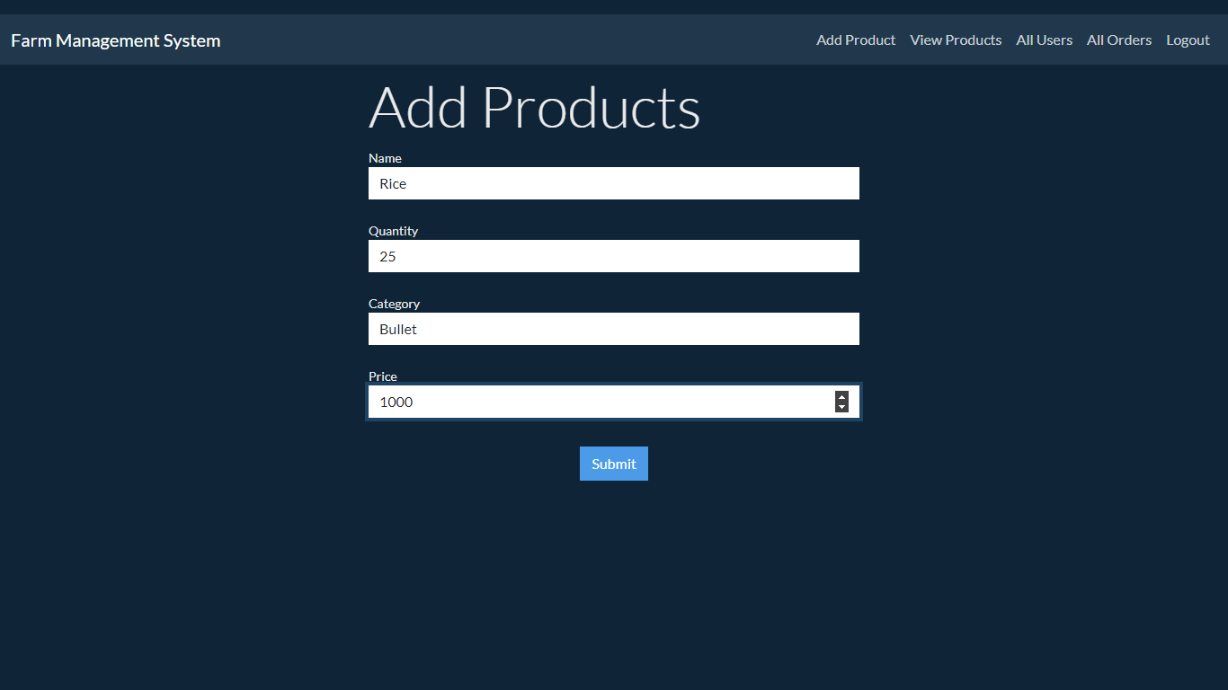
Add product: Here admin can all the products.

Slide 35
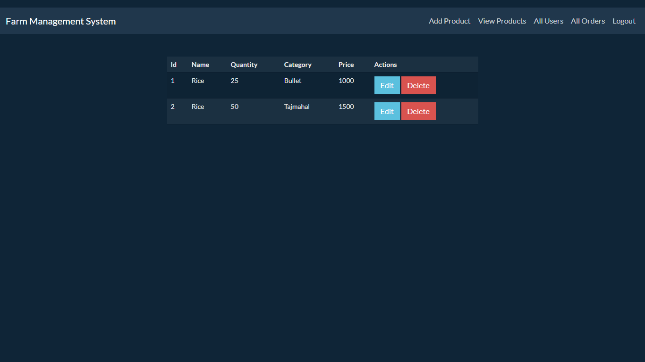
View products: Here the admin can view all added products.

Slide 36
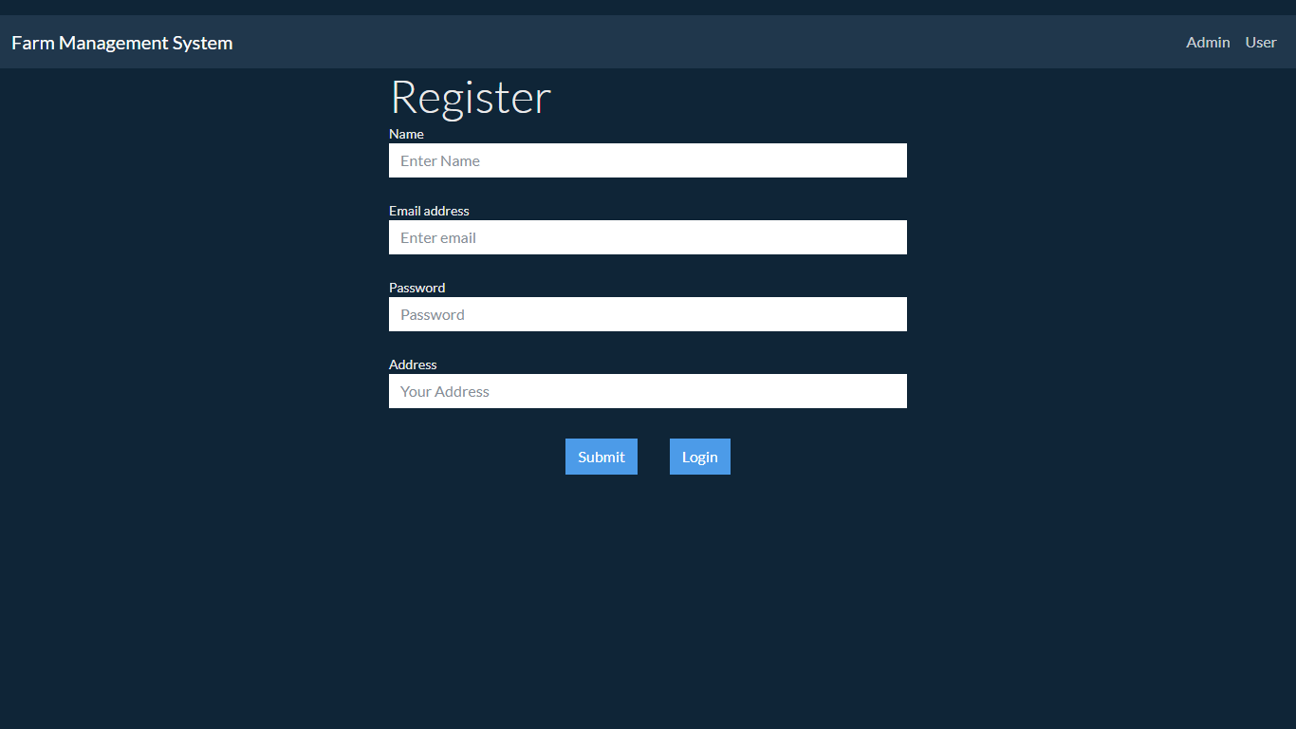
User register: Here user can register with their own details

Slide 37
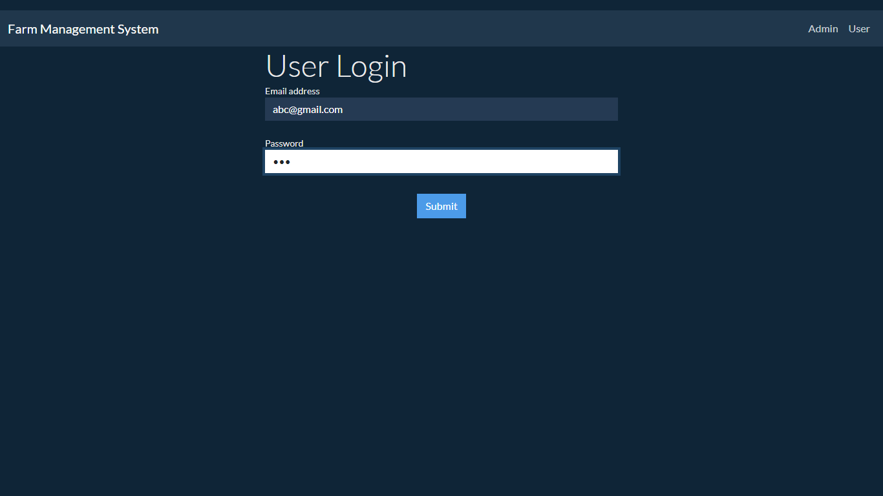
Logn: Here user can login with valid credentials

Slide 38
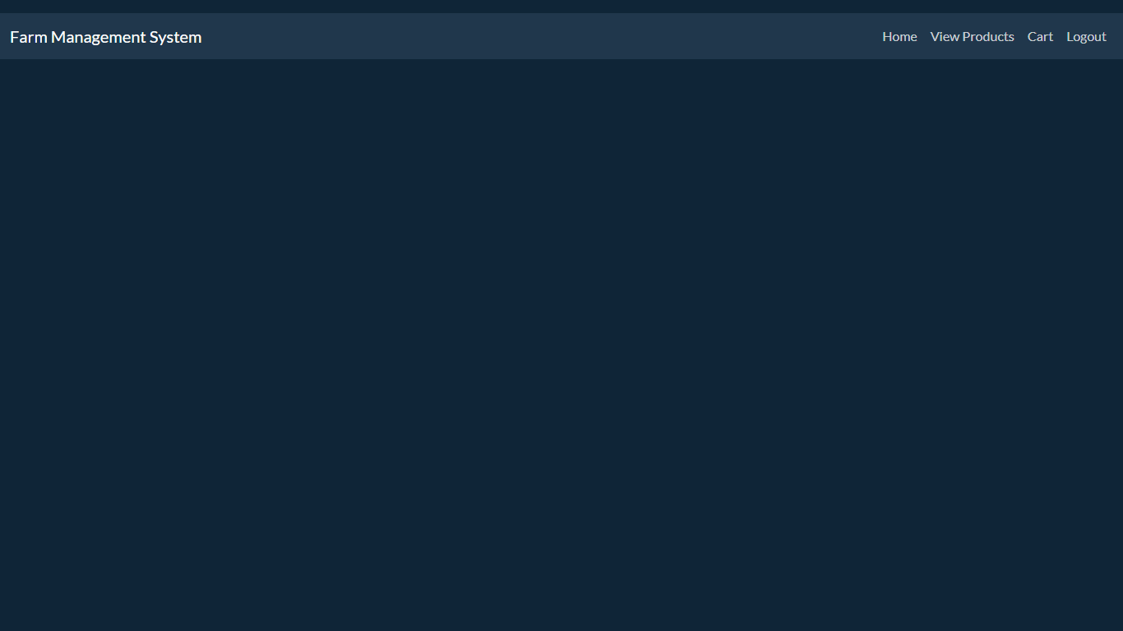
User Home: This is the home page of user.

Slide 39
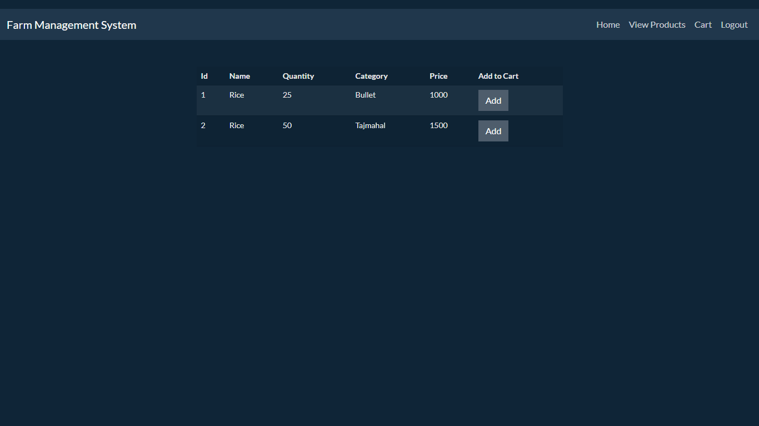
View products: In this page user can view all the products and can add to the cart.

Slide 40
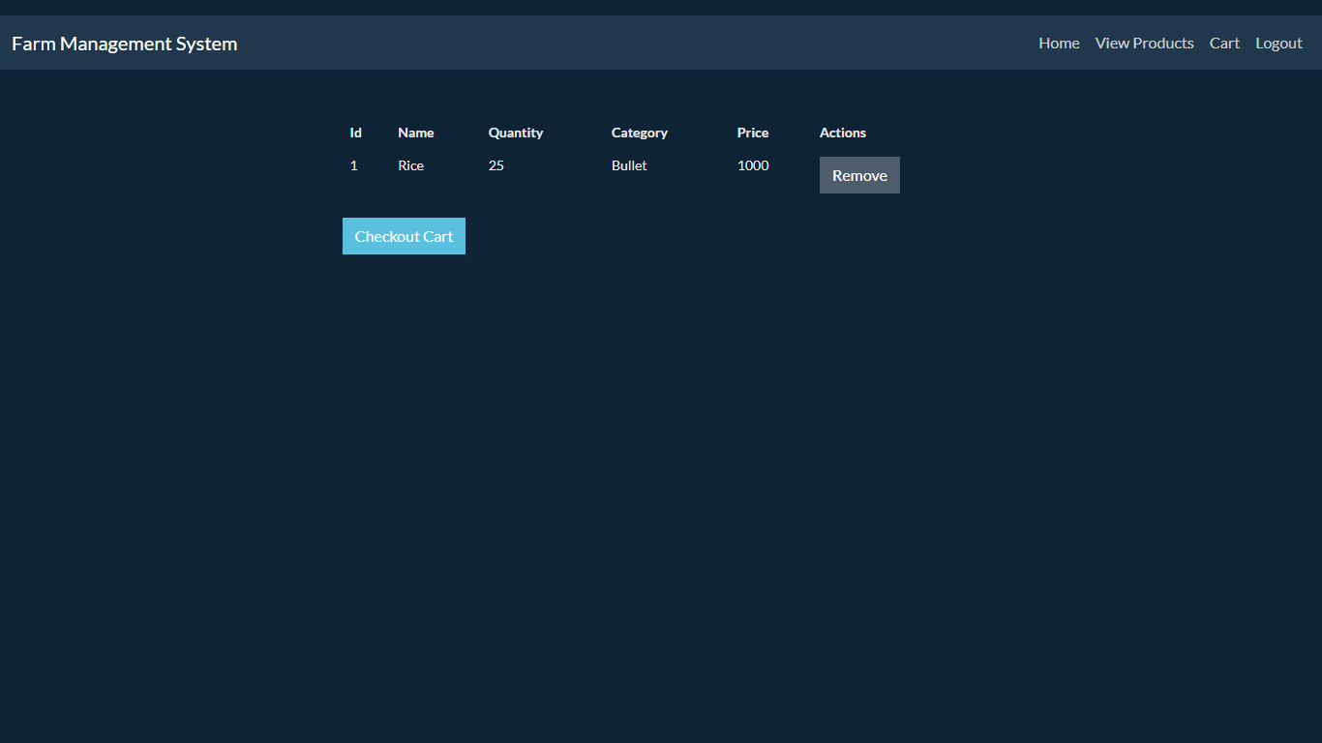
User cart: This is the user cart after checkout payment will be successful.

Slide 41
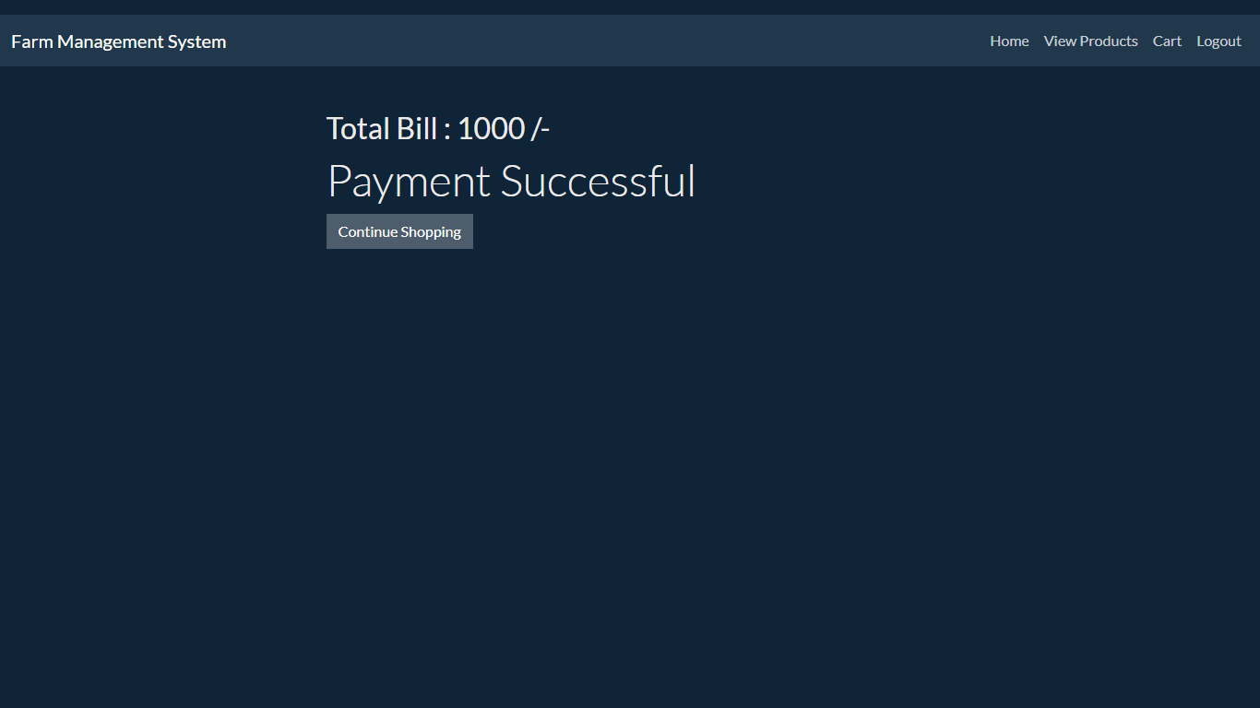
Acknolwdgement: In this page getting message for bill payment.

Slide 42
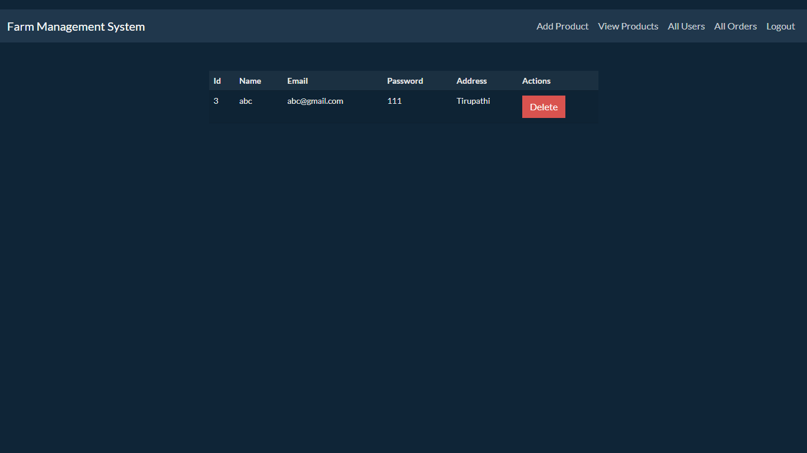
Users: In this page admin can view all the registered users.

Slide 43
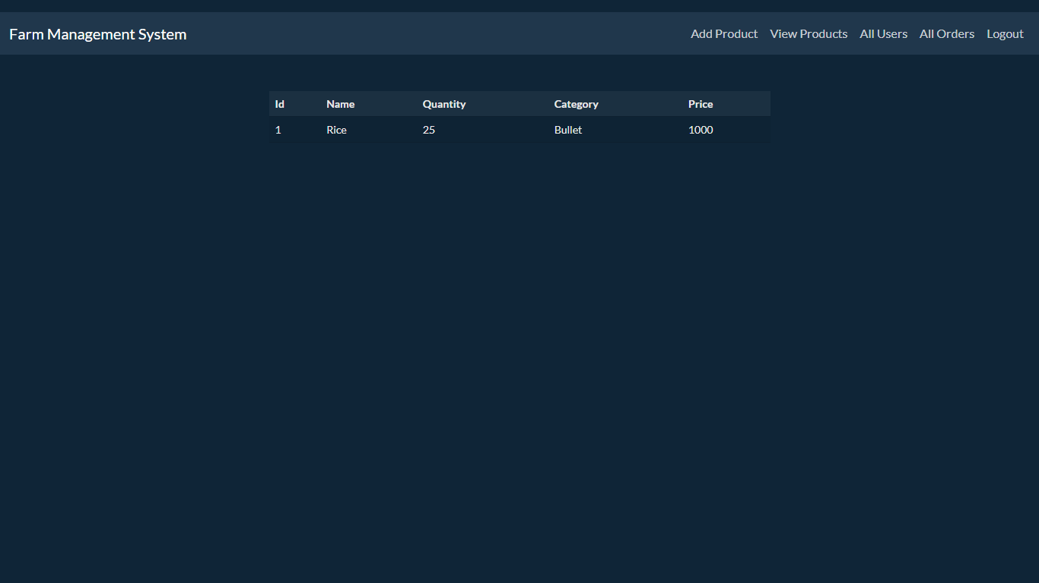
Orders: In this page admin can view all the orders were paid by users.

Slide 44
CONCLUSION
In this project we have successfully created a user friendly web application called Farm Management System which is useful to the buy products via online by order. The project's goal is to create an application software to lessen the human labour involved. Here the admin will check all the users, add the products , view added products and view all orders ordered by user . User can get all the details after login. when it comes to an application on real farms, a lot of adjustments have to be made to depict all production processes accurately.

Slide 45
REFERENCES
Bryant, L. (1999): Computers on the Farm. Farmers’ usage patterns and impact on the farm management, A report for the Rural Industries Research, RIRDC Publication,no.99.13.
Grubb, J. (2010): A Low Cost Automated Livestock Tracking System, Appalachian State University, 2010.
Cerosaletti, P.E., Fox, D.G., Chase, L.E. (2004): Phosphorus Reduction Through Precision Feeding of Dairy Cattle, Journal of Dairy Science, Vol. 87, no. 7, pp. 2314–2323
Kuhlmann, F., Brodersen, C. (2001): Information technology and farm management: developments and perspectives, Computers and Electronics in Agriculture, Vol. 30, no. 1, pp. 71–83.

Slide 46
Gygax, L., I. Neuffer, C. Kaufmann, R. Hauser, and B. Wechsler, Milk cortisol concentration in automatic milking systems compared with autotandem milking parlors Dairy Sci, 1889, pp.3447–3454
Bruckmaier, R. M., and J. W. Blum, “Oxytocin release and milk removal in ruminants,” Dairy Sci, 1981, pp. 939–949
Stojmenovic I, “T Localized network layer protocols in wireless sensor networks based on optimizing cost over progress ratio,” J. Network IEEE., 2006, pp. 21-27
Hillerton, J. E., J. W. Pankey, and P. Pankey, “Effect of over-milking on teat condition,” Dairy Res, pp. 81–84, 2002.

